Slide 1
Applications of Newton’s Law continued
(more on chapter 6)

Slide 2
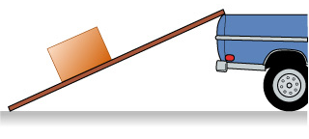

The crate is at rest on the incline. What is true of the force of static friction on the crate?
There is none, since the crate isn’t moving.
Its direction is up the incline.
Its direction is down the incline.
You can’t tell if there is static friction or not.
Table

Slide 3
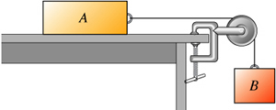
Suppose the connected blocks are moving at a constant speed (B down and A to the right.) There is friction between the table and block A. Draw force diagrams for both blocks. Next, compare the magnitudes of the forces of tension (T) and friction (f) on block A.
T > f
T < f
T = f
You need the speed to be able to tell
Table

Slide 4
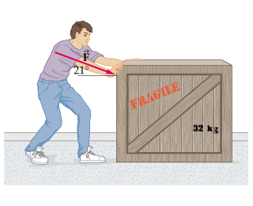
Which of the following equals the magnitude of the force of friction on the crate? (Hint – draw a force diagram and apply Newton’s 2nd law in the y direction.)
f = μmg
f = μ(mg + Fsin21°)
f = μ(mg – Fsin21°)
f = μ(mg + Fcos21°)
f = μ(mg – Fcos21°)
Table

Slide 5
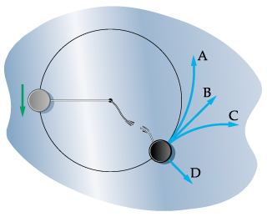
A puck attached to a string is moving in a circle at a constant speed on a level air hockey table. Consider the puck before the string breaks. What force is providing the centripetal force on the puck?
Normal force
Weight (force of gravity on the puck)
Tension
Applied force
Table

Slide 6
A puck attached to a string is moving in a circle at a constant speed on a level air hockey table. Consider the puck before the string breaks. What is the direction of the centripetal force on the puck?
In towards the center of the circle
Out directly away from the center of the circle
Tangent to the circle in the direction the puck is moving
Tangent to the circle opposite the direction the puck is moving
Table

Slide 7
A puck attached to a string is moving in a circle at a constant speed on a level air hockey table. Consider the puck before the string breaks. What is the direction of the centripetal acceleration on the puck?
In towards the center of the circle
Out directly away from the center of the circle
Tangent to the circle in the direction the puck is moving
Tangent to the circle opposite the direction the puck is moving
None – there is no acceleration because the puck is moving at a constant speed
Table

Slide 8
A puck attached to a string is moving in a circle at a constant speed on a level air hockey table. Now consider the moment the string breaks, as shown. Which letter indicates the path the puck will follow?
A
B
C
D
Table

Slide 9
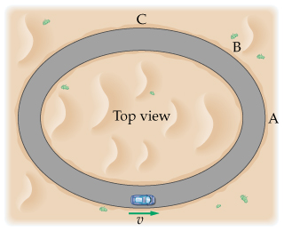
A car is moving around the oval track. Assuming that the track is level (not banked,) what provides the centripetal force?
Weight (force of gravity on car)
Friction
Normal force
A combination of these
Table

Slide 10
Consider the situation in the previous question. At which point can the car go the fastest before slipping?
A
B
C
The maximum possible speed is the same everywhere
Table

Slide 11
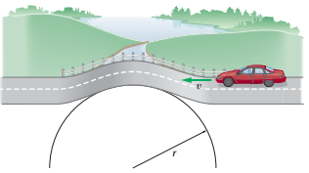
Draw a force diagram for the car at the moment it is at the top of the small rise in the road. What is the centripetal force on the car equal to at this moment?
N
mg
N-mg
mg-N
N+mg
Table

Slide 12
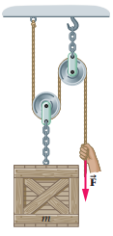
The mass of the crate shown is m. Assume the masses of the chains, rope, and pulleys are negligible. Find the magnitude of the force, F, needed to raise the crate at a constant speed.
F = mg
F = 2(mg)
F = (mg)/2
F = 3(mg)
F = (mg)/3
Table

